Slide 1

PRESENTED BY GROUP 8: Keise, Christine, Sara, Kelby

Slide 2

OPERATIONAL STRATEGY ANALYSIS

Slide 3

AMAZON CLOUD STORAGE SERVICES

Slide 4


Organizational Strategy
AWS is used to power Amazon.com.
It allows the company to expand its cloud computing platform.
AWS is responsible for 30% of the 16 billion cloud infrastructure services market.

Slide 5
SWOT Analysis
Strengths:
· AWS cloud is currently the most popular web service, with 21 products available
· The average consumer spends $124,000 per year on AWS cloud services
· From 2014 to 2015, consumers are predicted to increase spending by 43%.
· AWS valued at $5 billion in 2014. According to the Cowen and Co. report, AWS is predicted to reach $38 billion by 2020.
· Offers a three month trial period for its web services. Amazon Prime members receive added benefits, such as Unlimited Photos.

Slide 6






SWOT Analysis
Strength: Companies that use Amazon Web Services

Slide 7
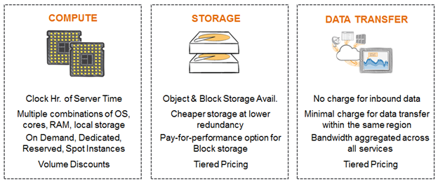
SWOT Analysis
Weakness:
· Pricing is determined by “Clock Hour of Server Time”

Slide 8


SWOT Analysis
Other Weaknesses:
· “Amazon Glacier” is an inexpensive alternative for cloud storage,
but it can take hours to retrieve data
· Security will always be an issue for consumers
· Expansion: the future of Amazon can be tricky

Slide 9

SWOT Analysis
Opportunities:
· Aggressively expand and research the market due to the increasing number of competitors offering web services
· Customer service and support have been key areas needed for improvement
· Hire analysts to conduct consumer research in order to “look for changes in developer productivity, business agility, and ability to deliver new applications”
· Amazon Free Tier (for one year)

Slide 10


SWOT Analysis
Threats:
· Competitors include Google, Microsoft, CenturyLink, VMware, IBM, and Rackspace
Google Drive
- Requires very little setup
-Links to Google to easily save attachments, documents, and share content
-Gaining market share
-Included in all Windows 10
-Based off the success of Microsoft

Slide 11

Operational Strategy
Low cost
No upfront investment
Flexibility and elasticity
Secure with the data
Global reach
Speed and agility

Slide 12
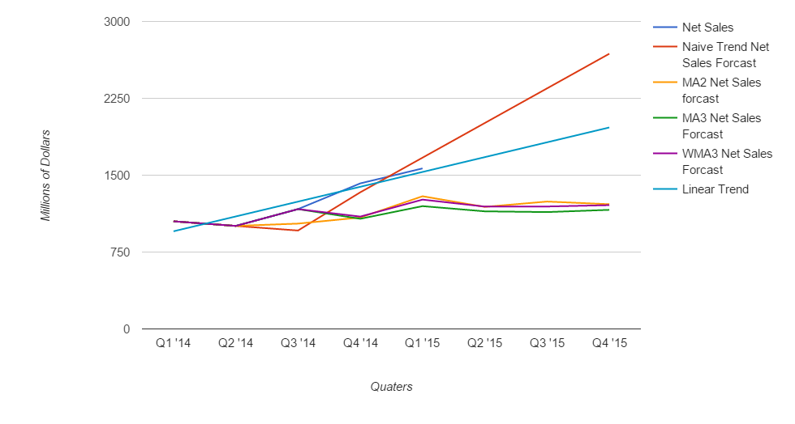
Forecasting Data

Slide 13
Forecast Error
 | Naive Trend Net Sales Forecast |  | MA2 Net Sales forecast |  | MA3 Net Sales Forecast |  | WMA3 Net Sales Forecast
Deviation | 586 | Deviation | 1379.25 | Deviation | 1390.111111 | Deviation | 1258.85
MAD | 97.66666667 | MAD | 229.875 | MAD | 231.6851852 | MAD | 209.8083333

